Slide 1
ENSE 470 Milestone 2
Jeremy Cross
Iden Ellia
Abdullah Alasmari

Slide 2
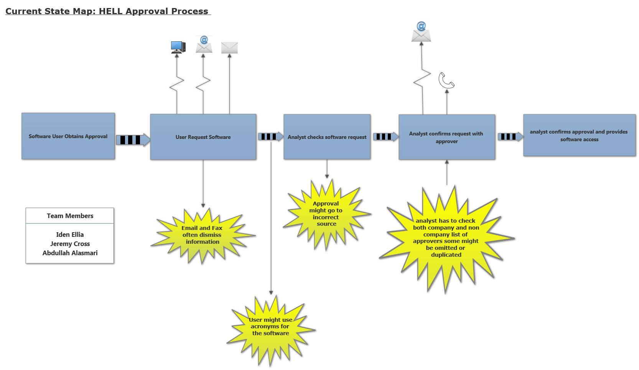
Recalling Current State VSM and Kaizen Bursts

Slide 3
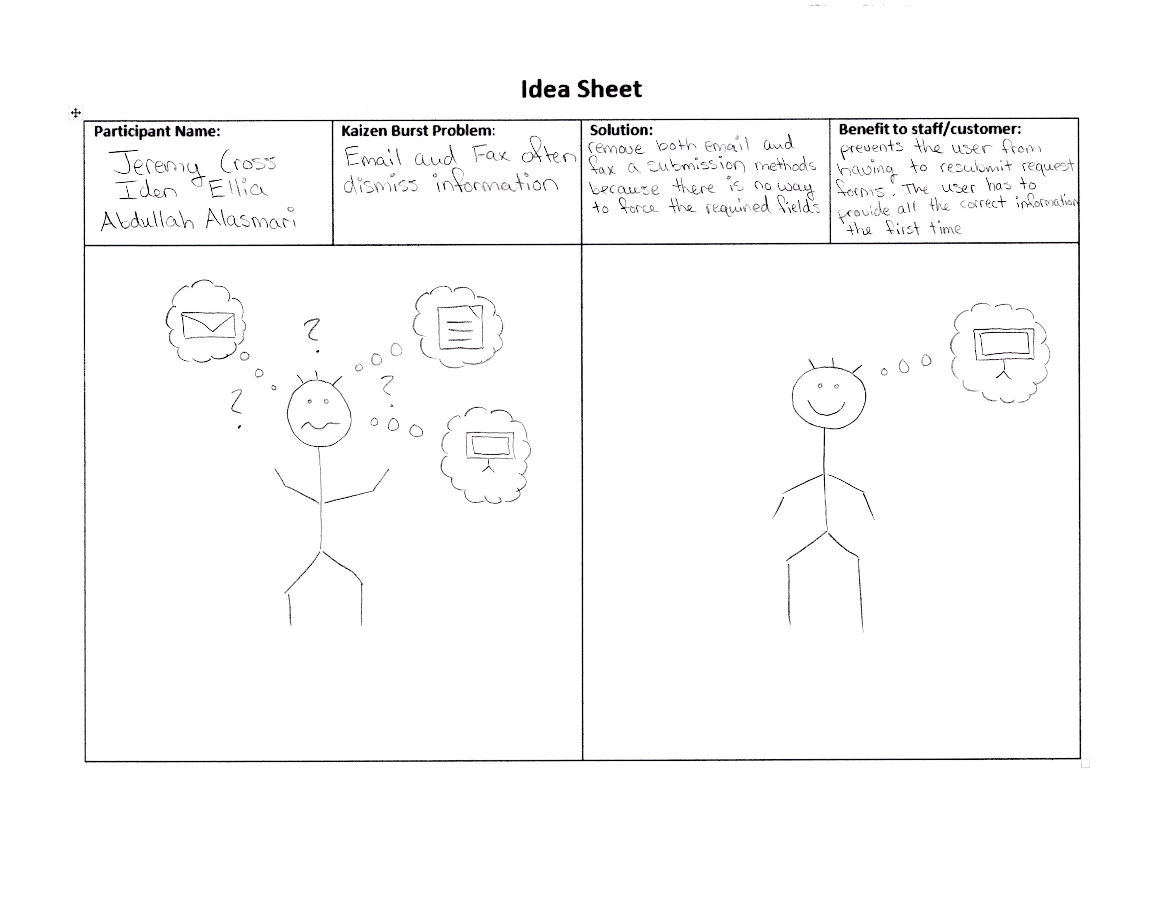

Slide 4
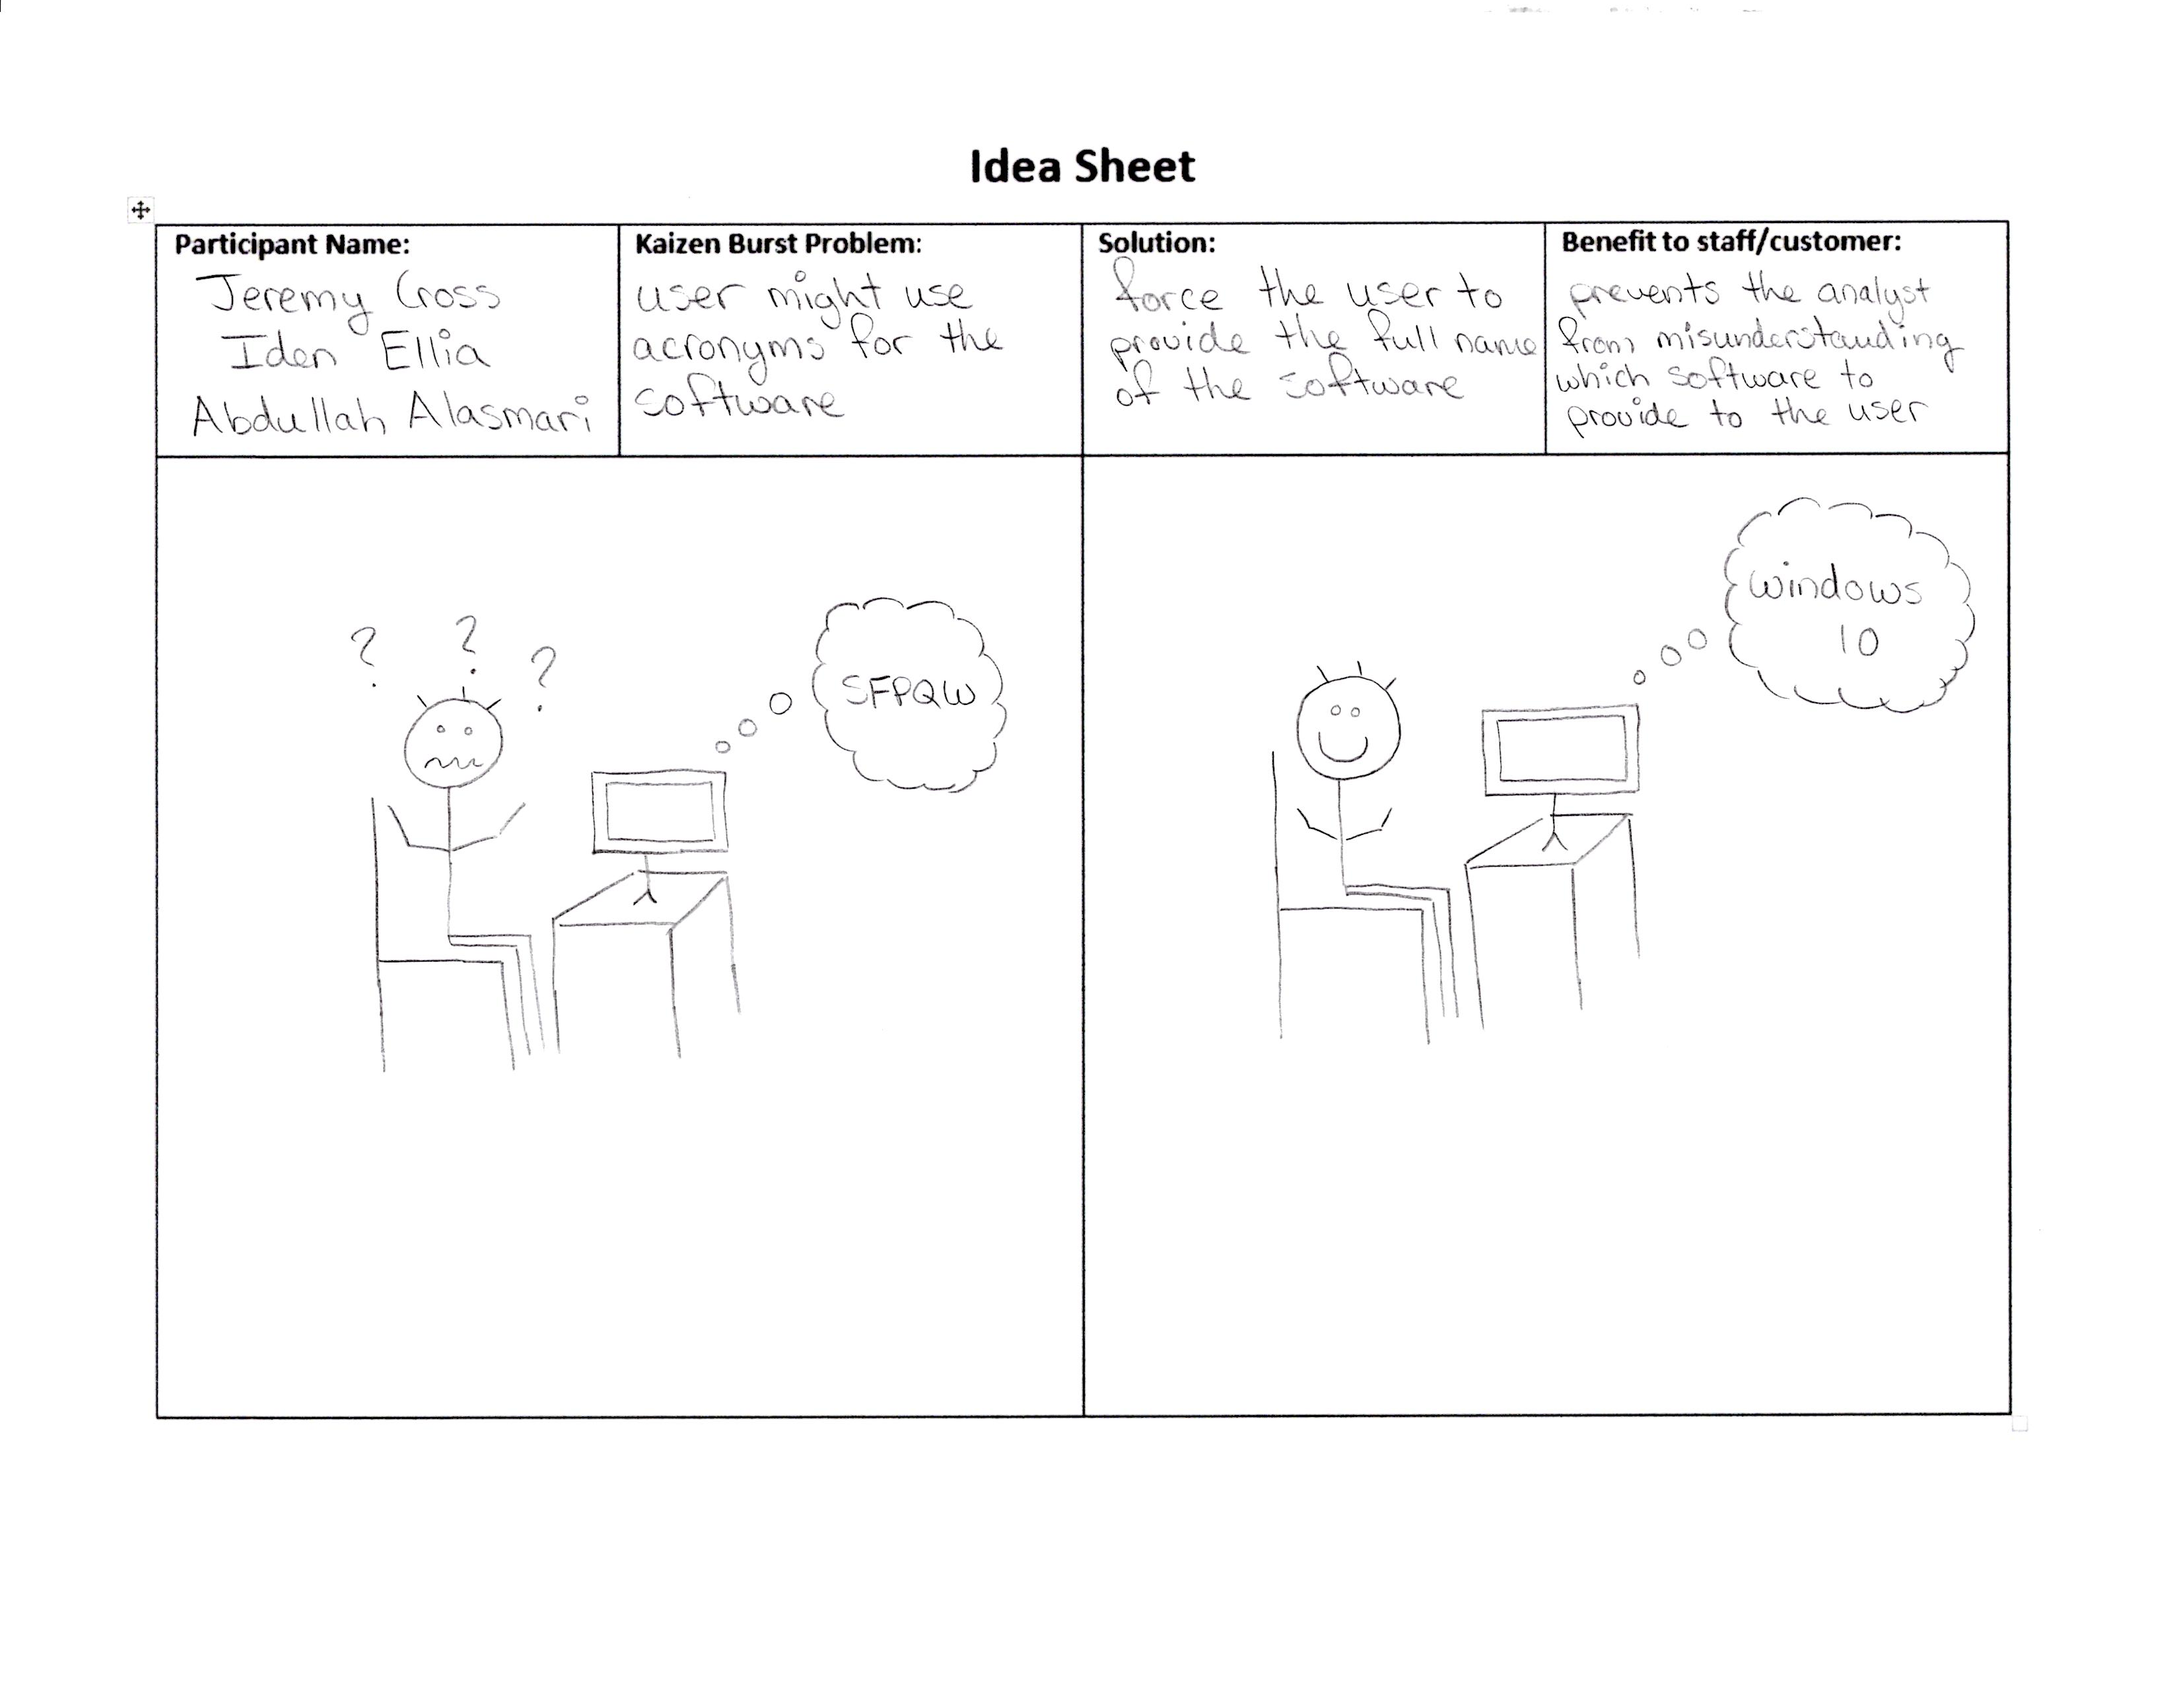

Slide 5
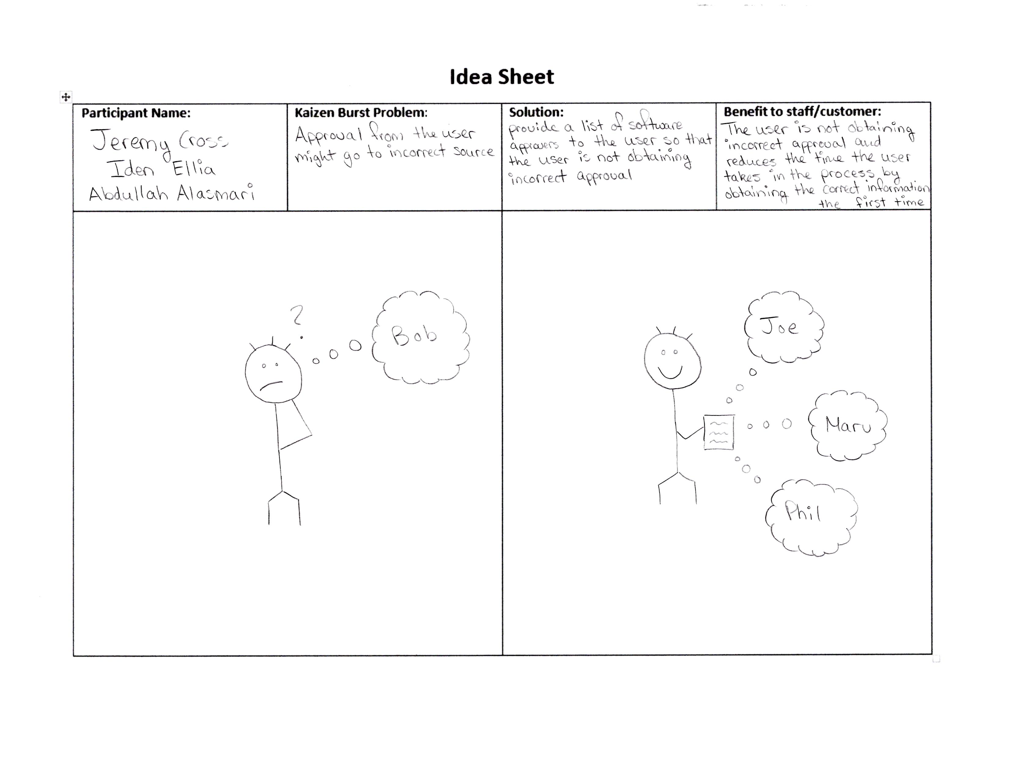

Slide 6
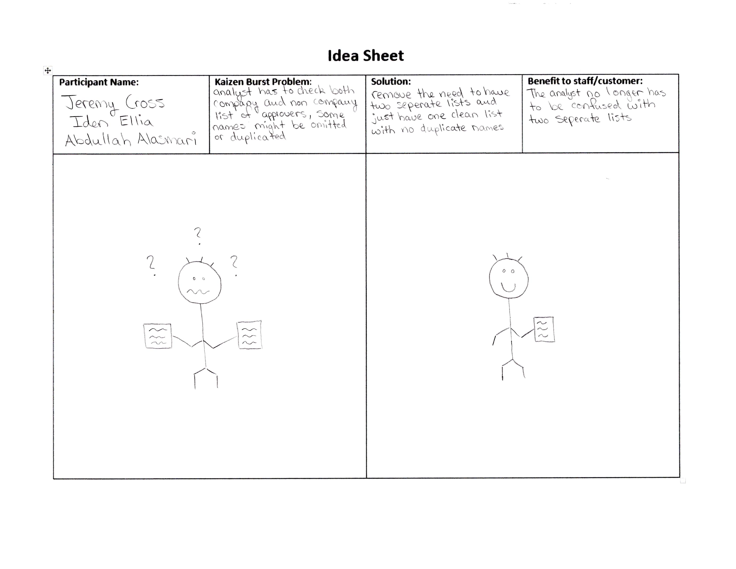

Slide 7
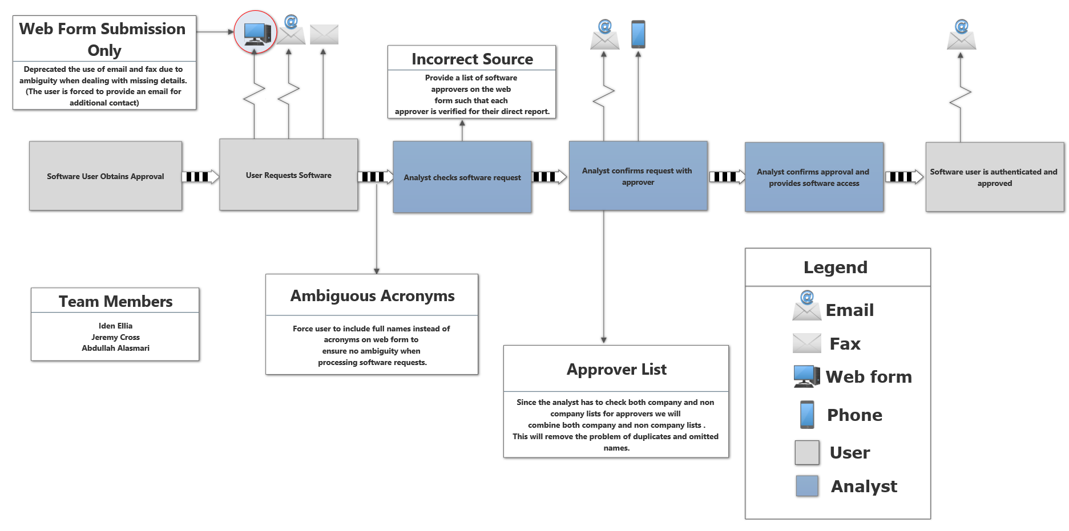
Future state VSM

Slide 8
Group reflection
How did you feel about this milestone? What did you like about it? What did you dislike?
We became more comfortable using smartdraw which made making the future state diagram easyer
What did you learn about yourself as you collaborated and worked through this milestone?
We learned how to create idea sheets
Learned how to draw stick people lolz
How will you use what you have learned going forward?
We will use our future state diagram for our user story map in milestone 3
What “stuff & things” related to this milestone would you want help with?
We are not sure what to put for participant name

